Slide 1
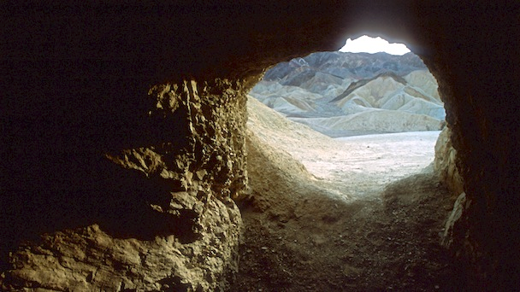
David’s Mercy
1 Samuel 24

Slide 2
1 Peter 1:7 That the trial of your faith, being much more precious than of gold that perisheth, though it be tried with fire, might be found unto praise and honour and glory at the appearing of Jesus Christ:

Slide 3
Romans 5:3-5 And not only so, but we glory in tribulations also: knowing that tribulation worketh patience; 4 And patience, experience; and experience, hope: 5 And hope maketh not ashamed; because the love of God is shed abroad in our hearts by the Holy Ghost which is given unto us.

Slide 4
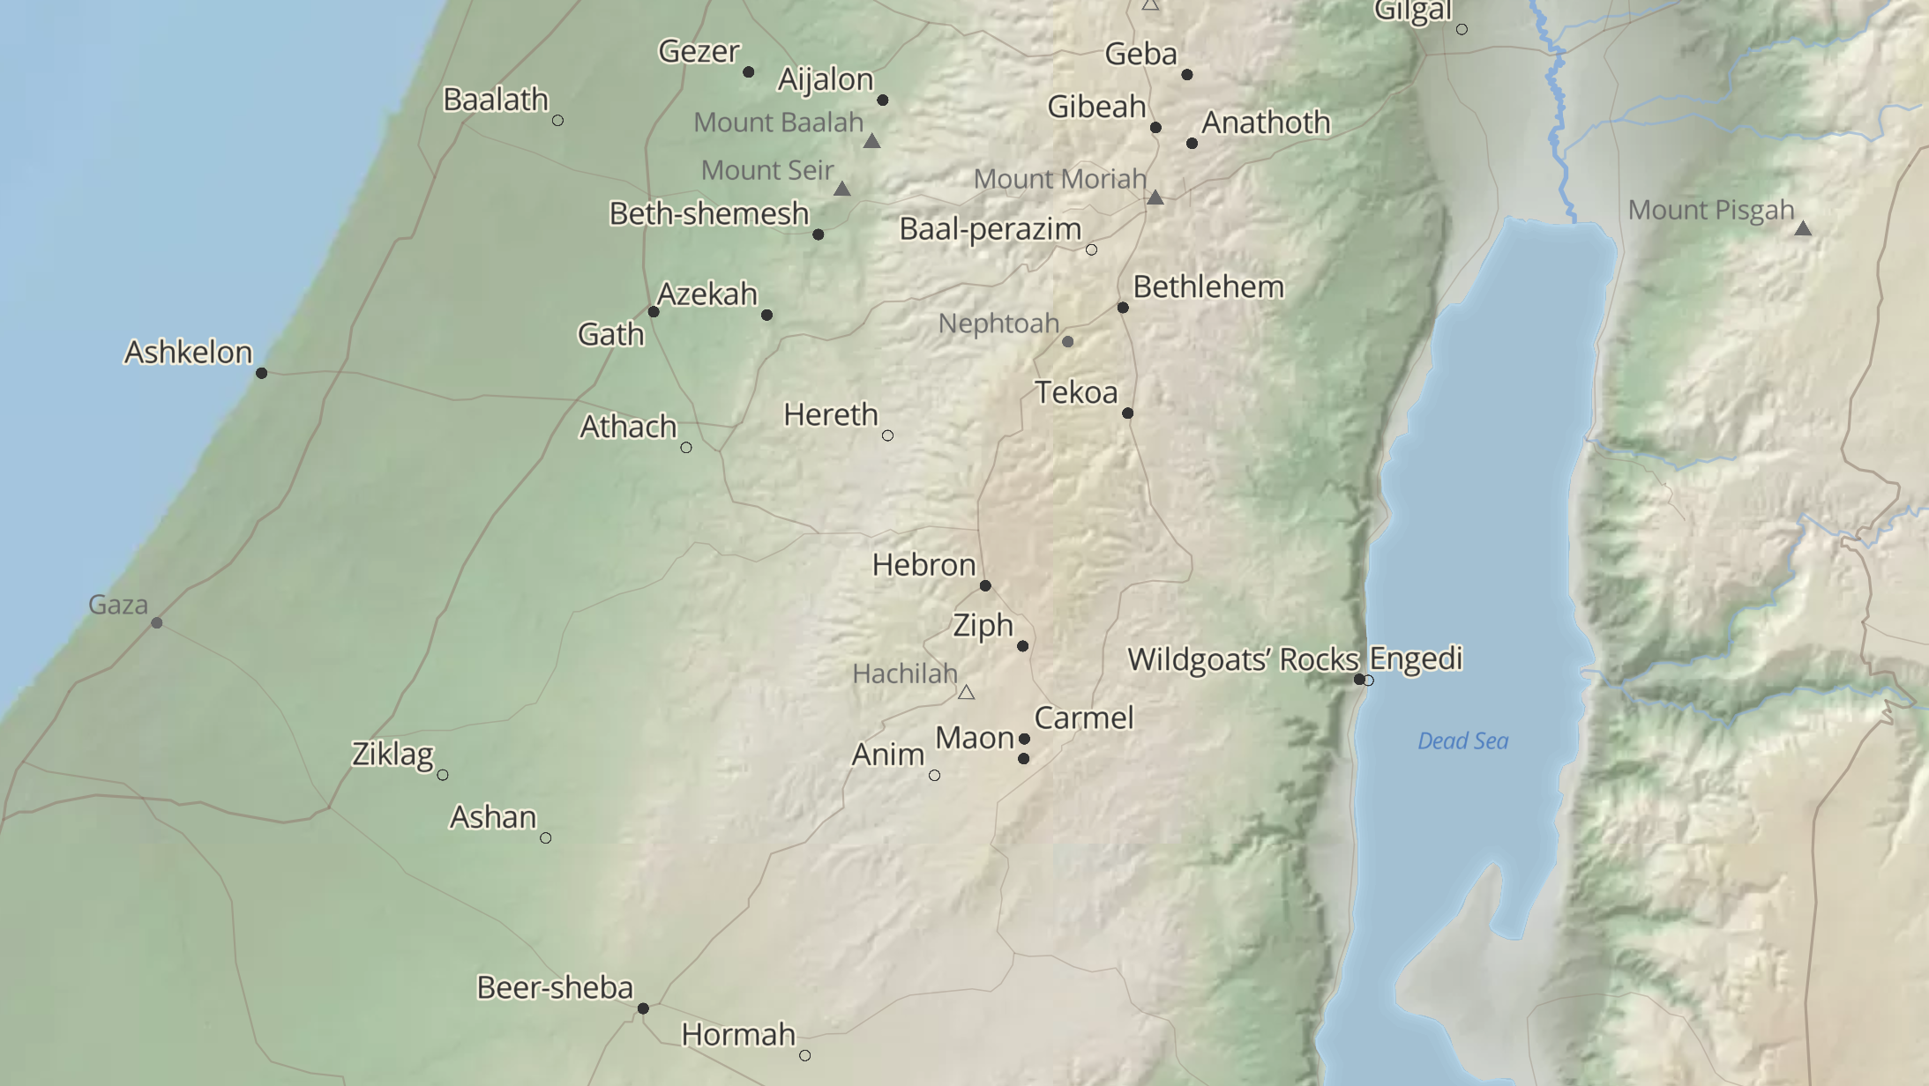


Slide 5

Respect for the office.
Another attack.
With overwhelming force.
5 to 1
The goal? Overturn Samuel’s prophecy.
Satan’s goal? Cut off the line of Messiah.
Saul needed potty or sleepy (private) time.

Slide 6
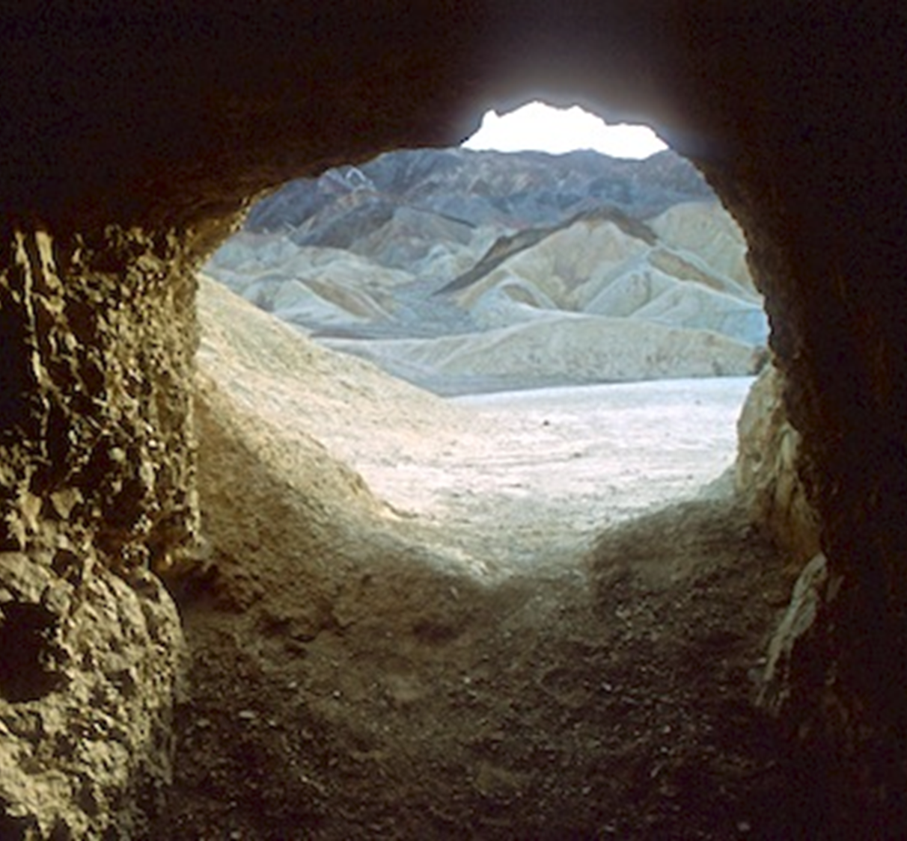
What are the odds that Saul would end up in Dave’s cave?
100 percent!
Those are God odds!

Slide 7
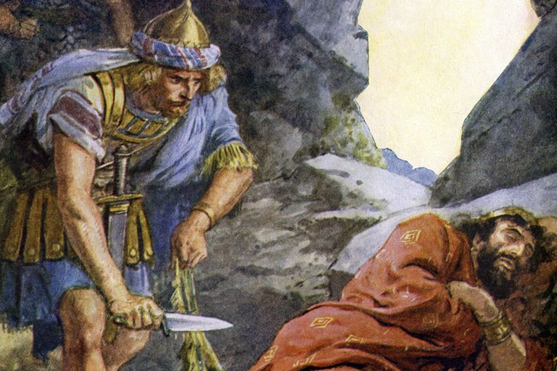
Respect for the office.
Potential poetic justice?
Skirt = wing, border, corner
Picture?
Saul’s rule will be cut off.
In taking the token, David’s heart smote him. Why?
David was under submission.
Saul was the Lord’s anointed.

Slide 8
Psalm 106:16-18 They envied Moses also in the camp, and Aaron the saint of the LORD. 17 The earth opened and swallowed up Dathan, and covered the company of Abiram. 18 And a fire was kindled in their company; the flame burned up the wicked.

Slide 9
Jude 1:8-10 Likewise also these filthy dreamers defile the flesh, despise dominion, and speak evil of dignities. 9 Yet Michael the archangel, when contending with the devil he disputed about the body of Moses, durst not bring against him a railing accusation, but said, The Lord rebuke thee. 10 But these speak evil of those things which they know not: but what they know naturally, as brute beasts, in those things they corrupt themselves.

Slide 10
Romans 13:1 Let every soul be subject unto the higher powers. For there is no power but of God: the powers that be are ordained of God.

Slide 11
1 Peter 2:13-17 Submit yourselves to every ordinance of man for the Lord's sake: whether it be to the king, as supreme; 14 Or unto governors, as unto them that are sent by him for the punishment of evildoers, and for the praise of them that do well. 15 For so is the will of God, that with well doing ye may put to silence the ignorance of foolish men: 16 As free, and not using your liberty for a cloke of maliciousness, but as the servants of God. 17 Honour all men. Love the brotherhood. Fear God. Honour the king.

Slide 12
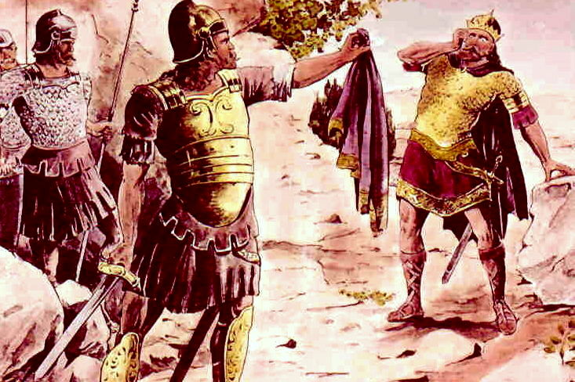
David: Faithful, Respectful, Humble.
David shows his care,
his submission, and
even his affection
for Saul!
KEY: Your conduct
proves your character.

Slide 13
Romans 12:19 Dearly beloved, avenge not yourselves, but rather give place unto wrath: for it is written, Vengeance is mine; I will repay, saith the Lord.

Slide 14

Crocodile tears are not the same as tears of repentance.
Men give evil for evil.
Godly men give good for evil.
Wicked men give evil for good.
Which is Saul? Wicked!

Slide 15
Matthew 7:16-18 Ye shall know them by their fruits. Do men gather grapes of thorns, or figs of thistles? 17 Even so every good tree bringeth forth good fruit; but a corrupt tree bringeth forth evil fruit. 18 A good tree cannot bring forth evil fruit, neither can a corrupt tree bring forth good fruit.
Matthew 12:33 Either make the tree good, and his fruit good; or else make the tree corrupt, and his fruit corrupt: for the tree is known by his fruit.
Matthew 12:34 O generation of vipers, how can ye, being evil, speak good things? for out of the abundance of the heart the mouth speaketh.

Slide 16
The PROBLEM?
Saul knows he’s WRONG, but he won’t REPENT!

Slide 17
2 Corinthians 7:10 For godly sorrow worketh repentance to salvation not to be repented of: but the sorrow of the world worketh death.

Slide 19
Proverbs 18:10 The name of the LORD is a strong tower: the righteous runneth into it, and is safe.

Slide 20
David’s Mercy
1 Samuel 24

